Slide 1
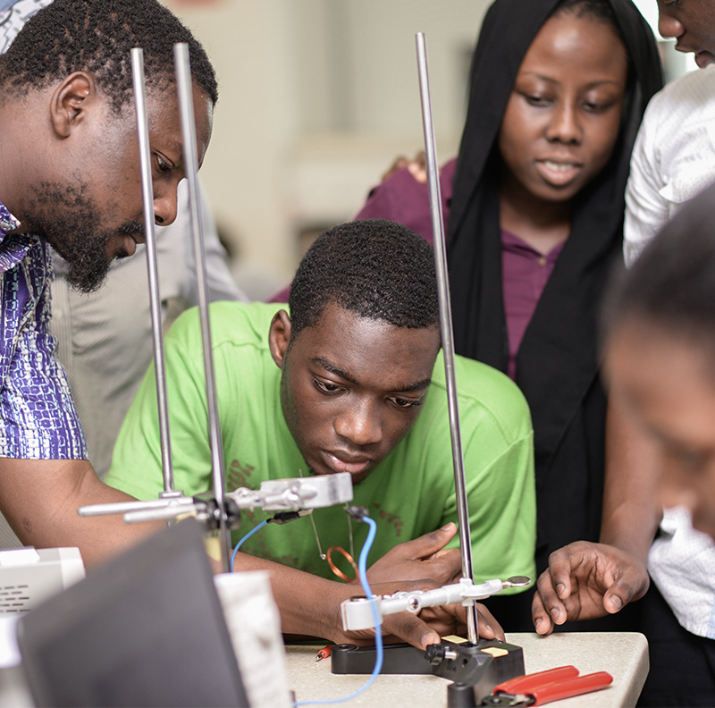


FINAL CAPSTONE PRESENTATION
TUTOR MANAGEMENT SYSTEM
(APPLIED PROJECT)
HOST
Emmanuel Teye-Kofi Odonkor

Slide 2
INTRODUCTION AND BACKGROUND OF PROBLEM
Getting the right academic support for University Education is challenging.
What are these challenges ?
Why is this PROBLEM of prior importance ?
APPLIED PROJECT

Slide 3
REVIEW OF A RELATED WORK to understand the problem
Related Work
“E-tutoring Support for Undergraduate Students Learning Computer Programming at the University of South Africa”
What was the PROBLEM and
SOLUTION proposed?
Relation of this work to my Capstone Project
APPLIED PROJECT

Slide 4

SUSTAINABLE DEVELOPMENT GOAL FOR THIS PROJECT
SDG 4: QUALITY EDUCATION
TARGET 4.6
INDICATOR
Literacy and NUMERACY
Proportion of the population achieves a fixed level of proficiency in Literacy, Functional and Numeracy Skills.
APPLIED PROJECT

Slide 5

REQUIREMENT ANALYSIS
Users
Ashesi Students
Ashesi Student Tutors
System Administrator
Departmental Coordinators
Mode of Gathering Requirements
Questionnaires / Online Survey
Methodology
Agile Development Approach
APPLIED PROJECT

Slide 6
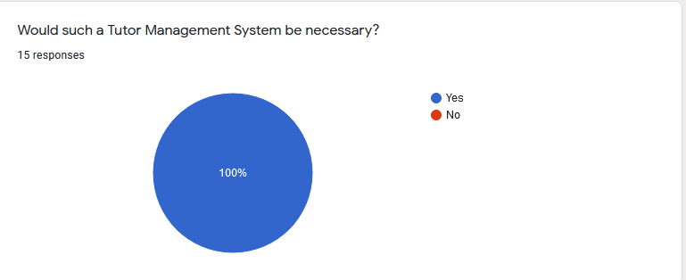
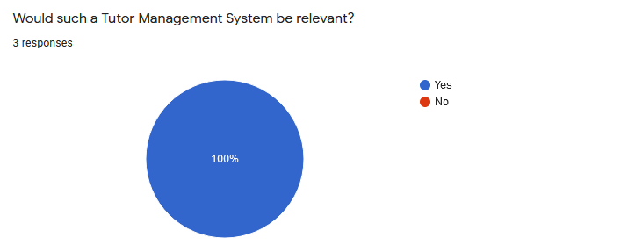
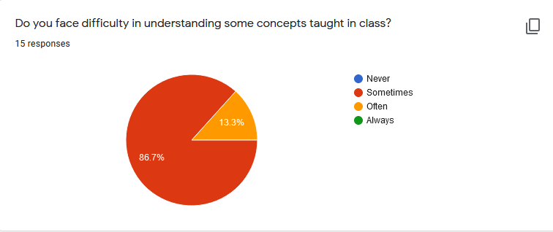
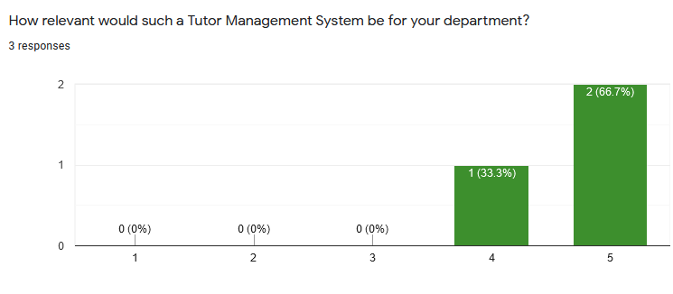
REQUIREMENT ANALYSIS – QUESTIONNAIRES AND RESULTS
ASHESI STUDENTS
FACULTY AND DEPARTMENTAL COORDINATORS

Slide 7
REQUIREMENT ANALYSIS – REQUIREMENTS
Functional Requirements
Non-Functional Requirements
APPLIED PROJECT

Slide 8
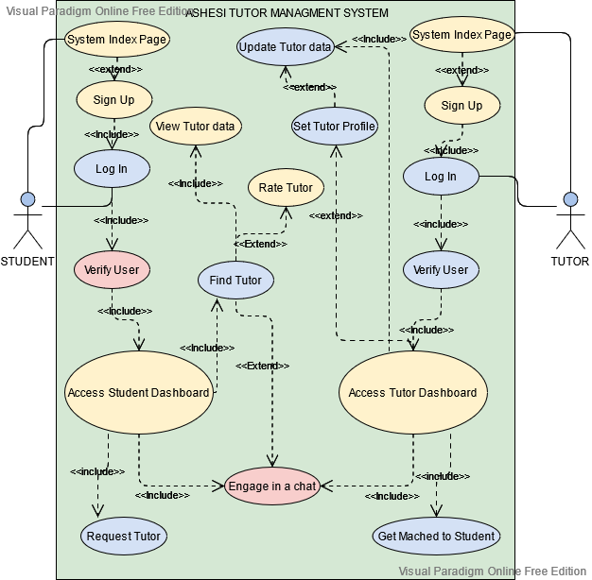
REQUIREMENT ANALYSIS – UML Diagrams
USE CASE DIAGRAM

Slide 9
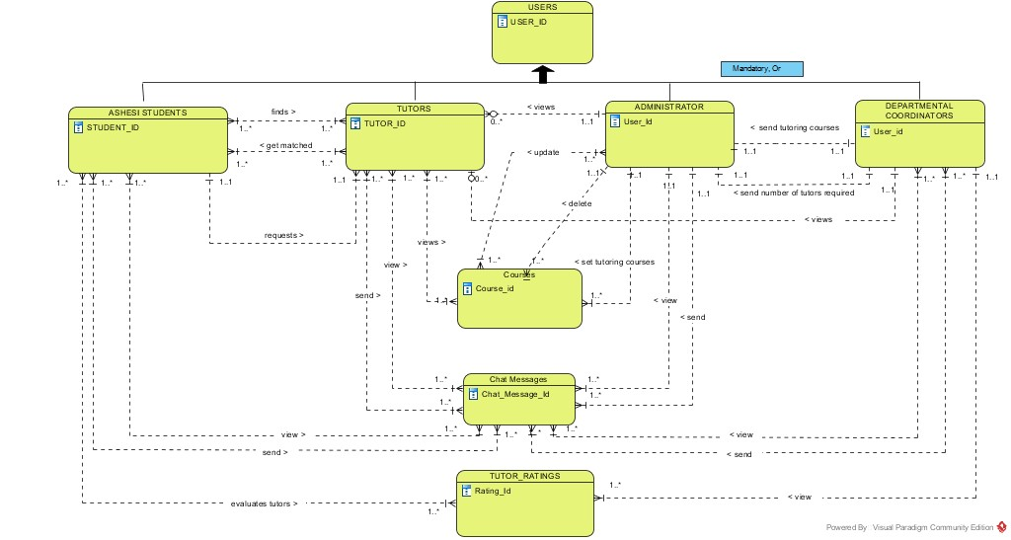
REQUIREMENT ANALYSIS – ENTITY RELATIONSHIP DIAGRAM
APPLIED PROJECT

Slide 10
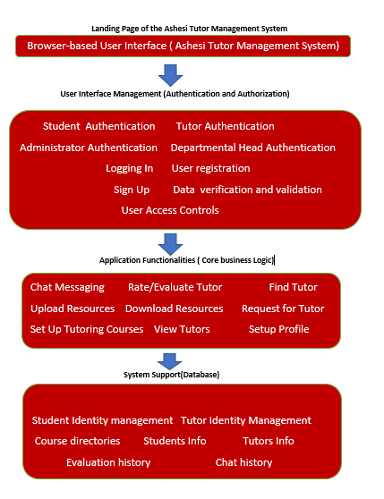
SYSTEM ARCHITECTURES
LAYERED ARCHITECTURE

Slide 11
IMPLEMENTATION – CONCEPTS, PRINCIPLES AND TOOLS USED
Front-End Architecture
HTML,CSS and JavaScript,
AJAX, jQuery, SweetAlert,
EmojioneArea Plugin,
HCI Principles
Database Architecture
Visual Paradigm
PhpMyAdmin
(Administration tool for MySQL)
Back-End Architecture
PHP (Hypertext Pre-Processor)
Local Development
XAMPP
Software Deployment
000webhost
FTP Client: FileZilla
APPLIED PROJECT

Slide 12

TESTING AND RESULTS
Automated Testing (Selenium)
Acceptance Testing
Successful Tests by Users
(Ashesi Students)
APPLIED PROJECT

Slide 13
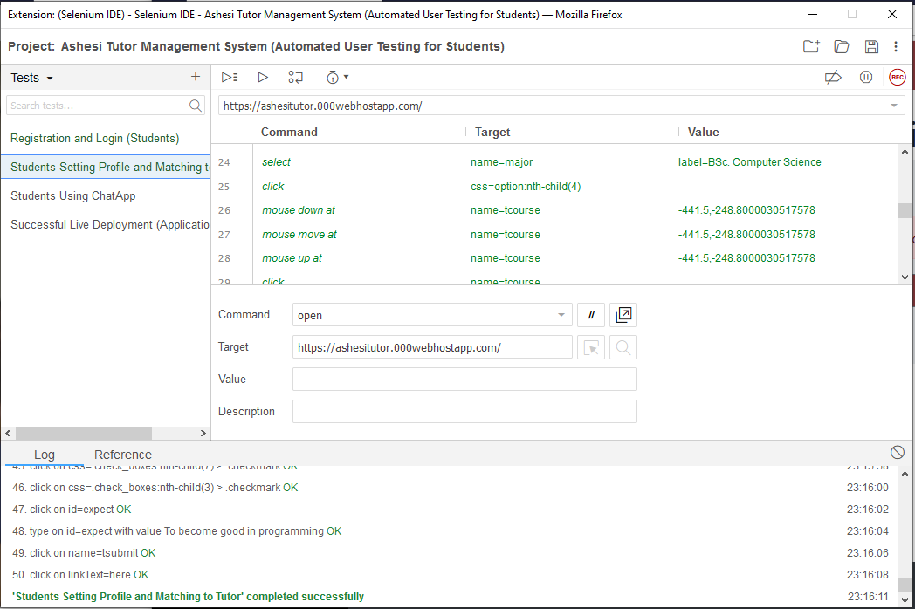
TESTING AND RESULTS -- SELENIUM TEST RESULTS
Student using the Student-Matching Portal

Slide 14
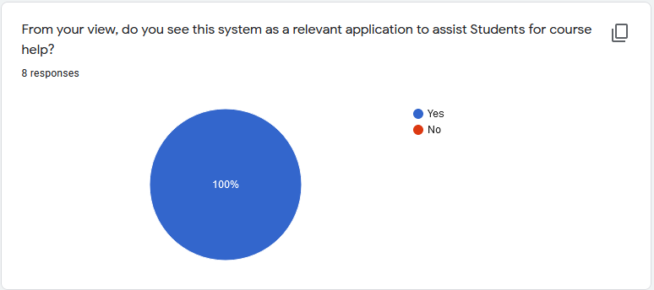
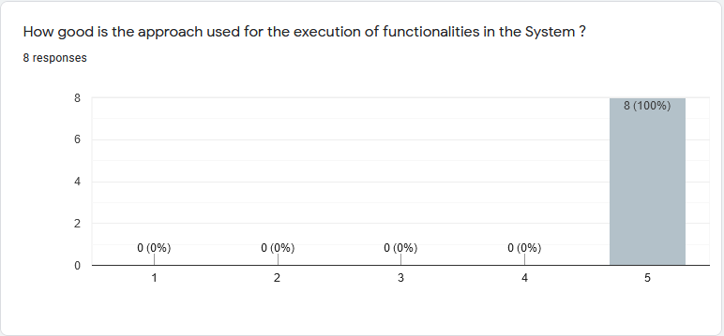
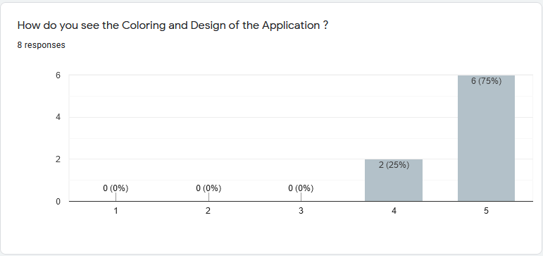
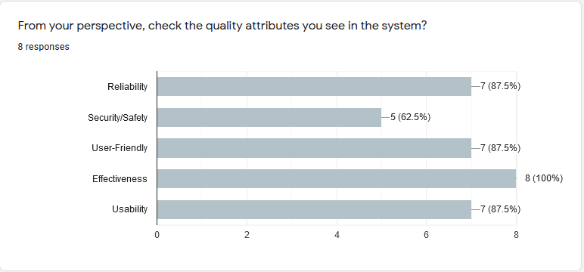
TESTING AND RESULTS -- ACCEPTANCE TESTING SURVEY RESULTS
APPLIED PROJECT

Slide 15
CONCLUSION AND RECOMMENDATIONS
Project Challenges
Conclusion
Future Works
APPLIED PROJECT

